Slide 1

2.x New Features
Ganesh Ramasubramanian
02-Dec-2016
Notes:
Hypermedia as the Engine of Application State

Slide 2
Agenda
Introduction
Pipeline concepts
Multi-branch Pipeline
Pipeline-as-Code

Slide 3
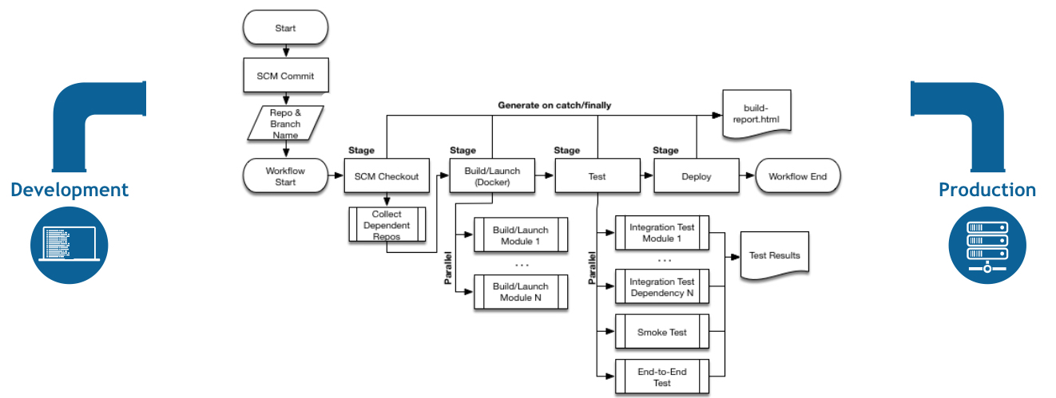
Real world

Slide 4
Introduction
Classic Job
Pipeline Job
Multi-branch

Slide 5
Pipeline Concepts
Node
Stage
Step
Notes:
Step
A "step" (often called a "build step") is a single task that is part of sequence. Steps tell Jenkins what to do.
Stage
A "stage" is a logically distinct part of the execution of any task
(Logical group of steps)
Node (where to run): Usually we run on a single node/agent everything unless there is a special need.
In pipeline coding contexts, a "node" is a step that does two things, typically by enlisting help from available executors on agents:
Schedules the steps contained within it to run by adding them to the Jenkins build queue (so that as soon as an executor slot is free on a node, the appropriate steps run).
Creates a workspace, meaning a file directory specific to a particular job, where resource-intensive processing can occur without negatively impacting your pipeline performance.
In Jenkins generally, "node" also means any computer

Slide 6
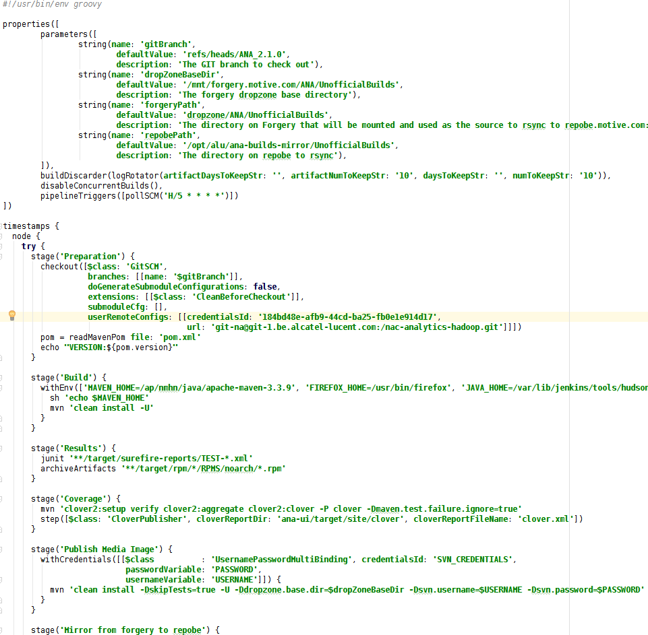
Pipeline-as-Code
Parameters
Stage-1
Stage-2
Stage-3

Slide 7
Pipeline Syntax
Pipeline DSL
http://<host:port>/job/<job-name>/pipeline-syntax/

Slide 8
Pipeline-as-Code
Properties step for
Triggers
Concurrent build
Automatic building
Control over SCM
Load Jenkinsfile automatically
Control over the stages, steps…
Build status
returnStdout & returnStatus options for sh & bat
Steps in a stage
Build
Test
Deploy

Slide 9
Pipeline-as-Code
Parallel steps with in a stage
Build
Build Test
Deploy
Test
Firefox
IE
Safari
Chrome
Upload to forgery
Mirror to repobe

Slide 10
Multi-branch Pipeline
Pipeline-as-Code
Groovy script
Part of SCM: Jenkinsfile
Jenkins will deduct automatically
No manual creation of job configuration !!!
Feature can be built automatically
You can reorder/add/update the pipeline for that feature
eg., add more tests

Slide 11
Blue ocean
Demo

Slide 12
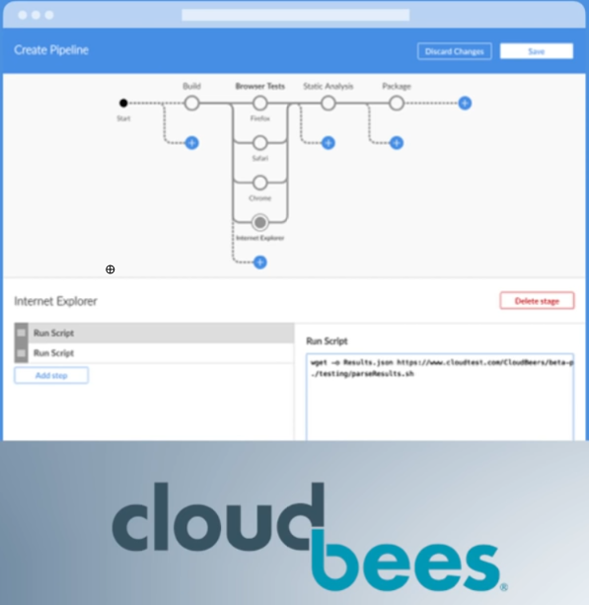
Pipeline design – Blue ocean (Q1 2017)
Pipeline editor

Slide 13
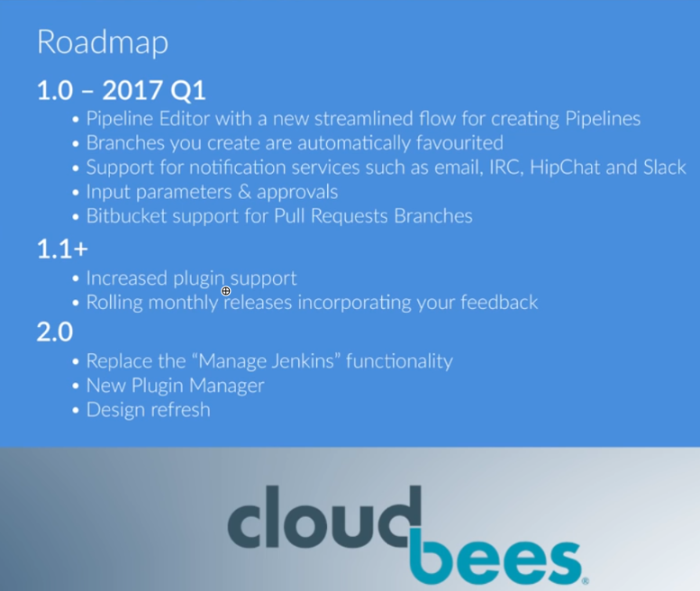
Roadmap – Blue ocean

Slide 14
Future Tech Sessions
09-Dec: Puppet Infrastructure and Deployment
16-Dec: Spring REST and HATEOAS in action
20-Jan: Apache Camel using Spring
Notes:
HATEOAS - Hypermedia as the Engine of Application State

Slide 15
References
Directions for Pipeline
https://www.youtube.com/watch?v=51fndpAWpYQ&feature=youtu.be
Pipeline concepts
https://jenkins.io/doc/book/pipeline/
Jenkins Blue ocean
https://jenkins.io/projects/blueocean/

Slide 16


